Slide 1

Title : Wildlife Tracker
Review 2

Slide 2

Team Details
Atul K. Singh(18BCE7078) Guided by :
K. Aditya Rajendra (18BCD7008) Prof. Nandeesh Kumar
Sharaj Chandran (18BCD7044) Dept. of Electronics Eng
Voruganti Sai Vamshi (18MSI7054)
Vedem Bhargav Reddy (18BCE7274)
Nandiwada Vishnu Manawani (18BEV7010)

Slide 3
LCD Module
To make the LCD to work with there is one missing component that is microcontroller that could be any like the 8086 or pic microcontroller in my case i have used a arduino uno
Arduino pins LCD pins 12 RS 11 E 5 DB4 4 DB5 3 DB6 2 DB7
The pins which we are going to use to connect it to any external microcontroller or microprocessor
RS(PIN=4)
E(PIN=6)
DB4(PIN=11)
DB5(PIN=12)
DB6(PIN=13)
DB7(PIN=14

Slide 4
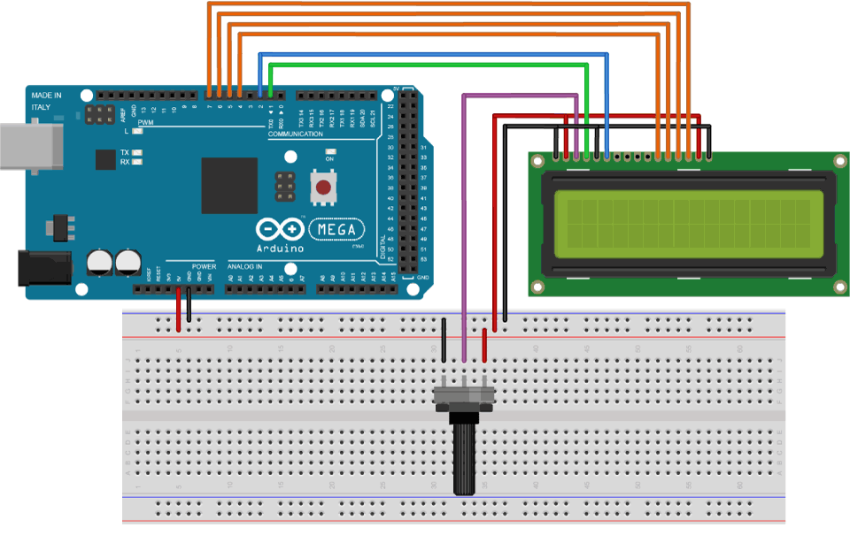
Circuit Diagram

Slide 5
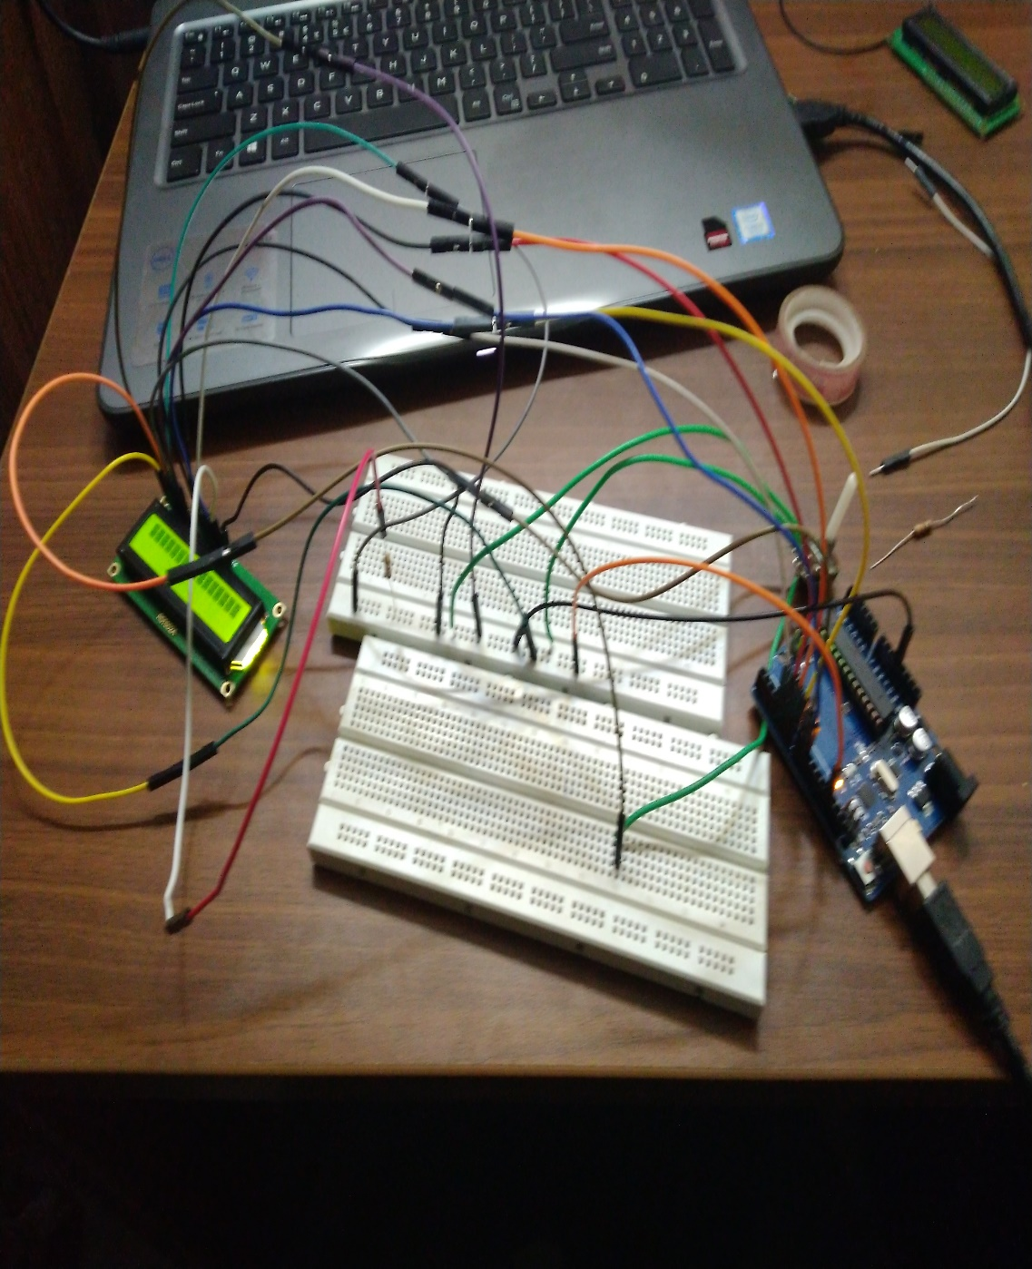
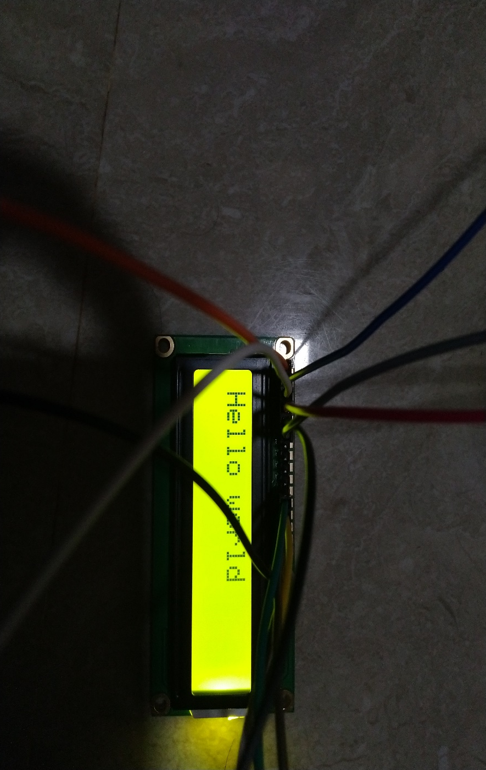
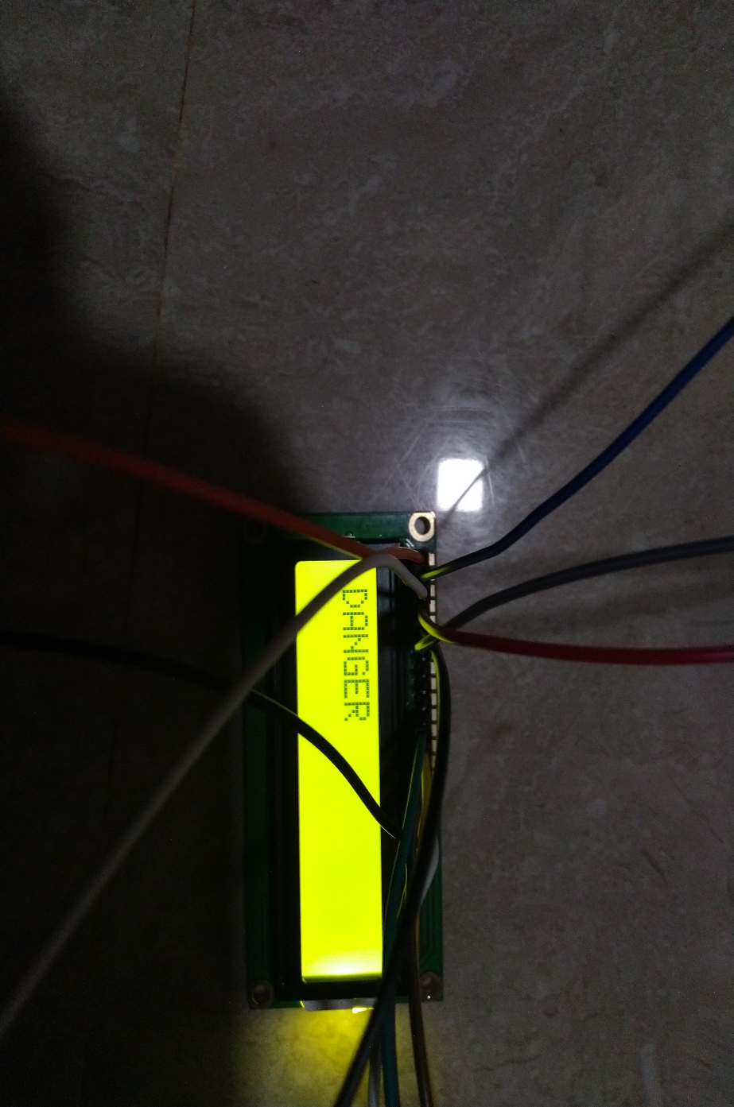

Slide 6
GSM Module
900 MHz frequency band
Power requirements
Sending messages using a mobile phone using GPRS

Slide 7
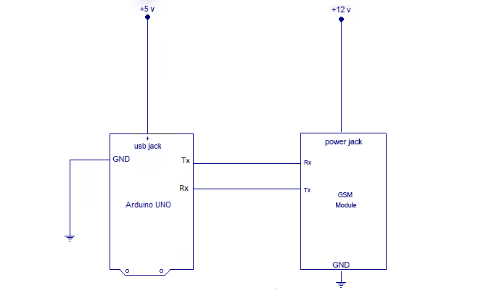
Circuit Diagram

Slide 8
GPS Module
GPS stands for Global Positioning System and it is a satellite based navigation system.
The GPS module used by us is the GPS Module NEO-6m.
The GPS module in our project is used to locate the position of a tagged animal and hence find its distance from the sensor.
The connections are as follows :
GPS – Arduino
GND – GND
TX – Digital pin (D3)
RX – Digital pin (D4)
Vcc – 5 V

Slide 9
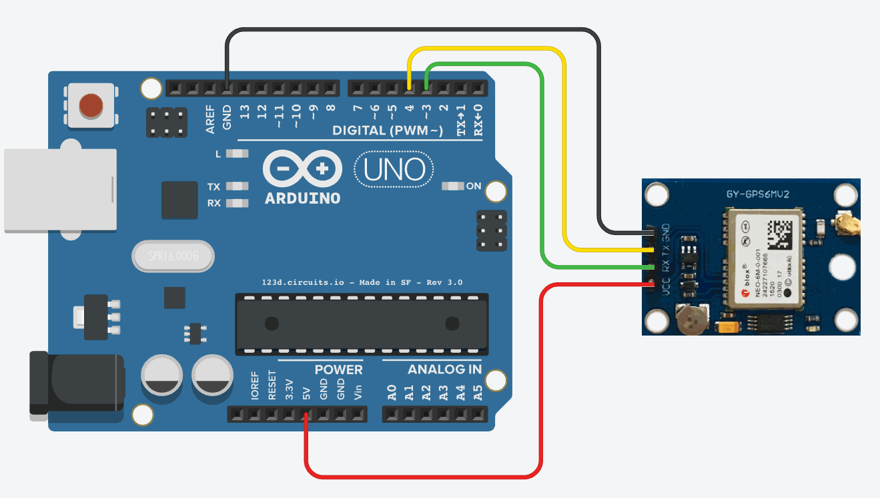
Circuit Diagram

Slide 10
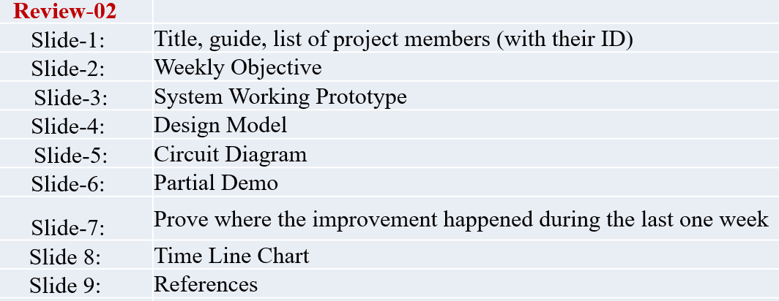
Content Details

Slide 11
Thank You

